Slide 1
Section 3.5 Implicit Differentiation
(Lecture Version)

Slide 2
Implicit is the opposite of Explicit.
In mathematics, an explicit function is a function of the form y = f (x), such as
$y=3x^{2}−5x+4, y=2\sin\left(x\right)−\cos\left(x\right), or y=5e^{\sqrt{6x−7}}$
In other words, the letter y appears on the left of the equal sign by itself, and it will not appear on the right-hand side of the equal sign.
And if the function is explicit, then it is (relatively) easy to differentiate – we just differentiate with respect to x on both sides of the equality, such as
$\frac{d}{dx}\left(y\right)=\frac{d}{dx}$($3x^{2}−5x+4$)
Therefore,
$\frac{dy}{dx}=6x−5$

Slide 3
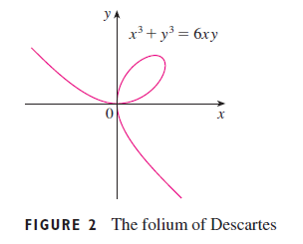
Implicit function on the opposite, is a function that is not (or cannot be) expressed as the form y = f (x).
One good example is the folium of Descartes (first proposed by Rene Descartes in 1638, who is the one invented the rectangular co-ordinates).
$x^{3}+y^{3}=6xy$
The curve looks like this,
It is true that this curve is the graph of any function, because it does not pass the vertical line test.
However, if we just consider a portion of this curve, such as the part in the 2nd quadrant, then it is the graph of some function, hence we should be able to find the derivative of this function in this neighborhood.

Slide 4
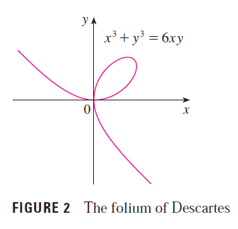
It is very difficult to solve for y from the equation
$x^{3}+y^{3}=6xy$
even though it can be done, and somebody did it,
(for just one part of the curve, we need other equations for other parts)
Obviously, this is not practical; no one likes to differentiate such a complicated function.
We need to learn how to find dy/dx without solving for y explicitly, and this method is officially called Implicit differentiation.
The idea is actually quite simple, provided that you have learned chain rule and product rule : we just differentiate both sides of the equality with respect to x, namely
$\frac{d}{dx}$($x^{3}+y^{3})=\frac{d}{dx}(6xy)$

Slide 5
$\frac{d}{dx}$($x^{3}+y^{3})=\frac{d}{dx}(6xy)$
$\frac{d}{dx}\left(x^{3}\right)+\frac{d}{dx}\left(y^{3}\right)=\frac{d}{dx}\left(6xy\right)$
Here we face the challenge of differentiating y³ and 6xy. We have to treat y as a function of x, such sin(x), ln(x) etc, and then use chain rule and product rule,
in particular
$\frac{d}{dx}\left(y^{3}\right)=\frac{dy^{3}}{dy}∙\frac{dy}{dx}=3y^{2}\frac{dy}{dx}$
according to chain rule.
And, $\frac{d}{dx}\left(6xy\right)=6x\frac{dy}{dx}+6y\frac{d}{dx}x=6x\frac{dy}{dx}+6y$
because $\frac{d}{dx}x=1.$
Therefore, $\frac{d}{dx}\left(x^{3}\right)+\frac{d}{dx}\left(y^{3}\right)=\frac{d}{dx}\left(6xy\right)$ can be rewritten as
$3x^{2}+3y^{2}\frac{dy}{dx}=6x\frac{dy}{dx}+6y$
Using the sum rule
Product rule

Slide 6
This is the new equation we have
$3x^{2}+3y^{2}\frac{dy}{dx}=6x\frac{dy}{dx}+6y$
You can see that it has the $\frac{dy}{dx}$ we want, and we have to solve for it from the equation.
$x^{2}+3y^{2}\frac{dy}{dx}=6x\frac{dy}{dx}+6y$ $⟹ 3y^{2}\frac{dy}{dx}=6x\frac{dy}{dx}+6y−3x^{2}$
$⟹ 3y^{2}\frac{dy}{dx}−6x\frac{dy}{dx}=6y−3x^{2}$
$⟹ \left(3y^{2}−6x\right)\frac{dy}{dx}=6y−3x^{2}$
$⟹ \frac{dy}{dx}=\frac{6y−3x^{2}}{3y^{2}−6x}$ this is what we are looking for!
Of course, this looks a bit strange - it has the letter y on the right-hand side, but this is because the function is an implicit function.

Slide 7
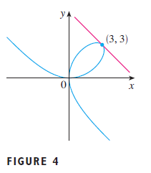
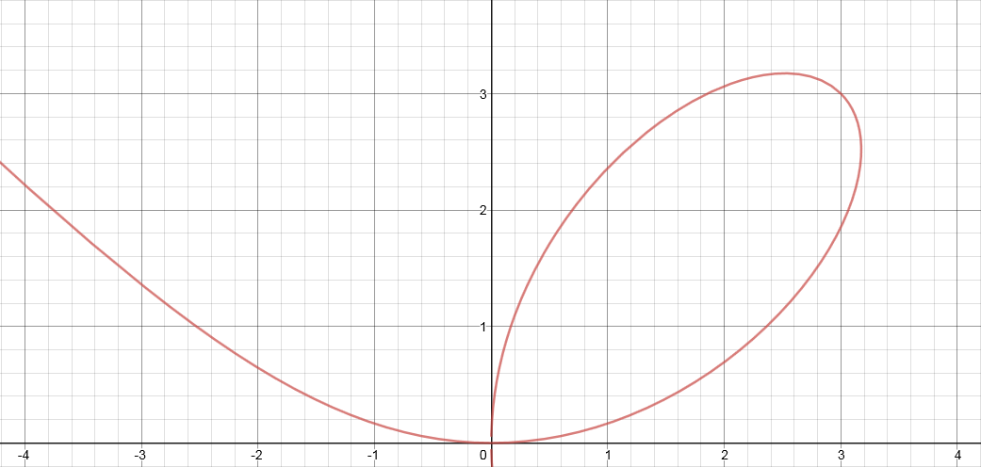
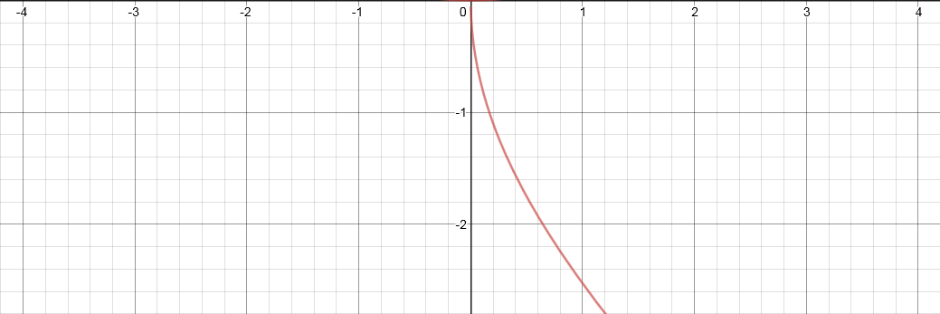
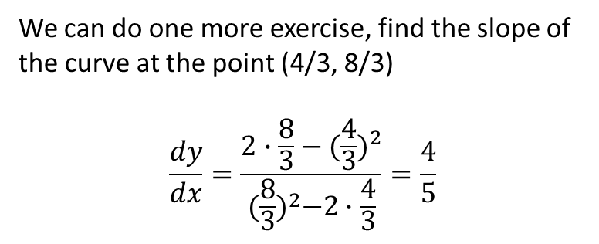
Once we have
we can find the slope of the tangent to the curve at the point (3, 3) by simply substituting x = 3, y = 3.
$\frac{dy}{dx}=\frac{2∙3−3^{2}}{3^{2}−2∙3}=−1$
The picture on the left confirms that our answer is right.
$\frac{dy}{dx}=\frac{6y−3x^{2}}{3y^{2}−6x}=\frac{2y−x^{2}}{y^{2}−2x}$
We can do one more exercise, find the slope of the curve at the point (4/3, 8/3)
$$\frac{dy}{dx}=\frac{2∙\frac{8}{3}−({\frac{4}{3})}^{2}}{{(\frac{8}{3})}^{2}−2∙\frac{4}{3}}=\frac{4}{5}$$

Slide 8
Intermission
(Let’s take a 10 min break)

Slide 9
More basic examples of implicit differentiation using the chain rule
$$\frac{d}{dx}\sqrt{y}=\frac{d}{dx}y^{1/2}=\frac{1}{2}y^{−1/2}\frac{dy}{dx}=\frac{1}{2\sqrt{y}}\frac{dy}{dx}$$
$$\frac{d}{dx}\sin{y}=\cos{y \frac{dy}{dx}}$$
$\frac{d}{dx}{(y^{4}+3y)}^{10}=10{(y^{4}+3y)}^{9}\frac{d}{dx}(y^{4}+3y$)
$=10{(y^{4}+3y)}^{9} ({4y}^{3}+3\text{)}\frac{dy}{dx}$

Slide 10
Solution: Differentiate both sides with respect to x.
$\frac{d}{dx}\sin\left(x+y\right)=\frac{d}{dx}(y^{2}\cos{x})$ (click when you want to see next step)
$⟹\cos\left(x+y\right)\frac{d}{dx}\left(x+y\right)=y^{2}\frac{d}{dx}\cos{x}+\cos{x}\frac{d}{dx}y^{2}$ because dsin(u)/du = cos(u)
$⟹ \cos\left(x+y\right)\left(1+\frac{dy}{dx}\right)=y^{2}(−\sin{x)}+(\cos{x})(2y\frac{dy}{dx})$
$⟹\cos\left(x+y\right)+cos⁡(x+y)\frac{dy}{dx}={−y}^{2}\sin{x}+2y\cos{x}\frac{dy}{dx}$
$⟹ \cos\left(x+y\right)\frac{dy}{dx}={−y}^{2}\sin{x}+2y\cos{x}\frac{dy}{dx}−cos (x+y)$
$⟹\cos\left(x+y\right)\frac{dy}{dx}−2y\cos{x}\frac{dy}{dx}={−y}^{2}\sin{x}−cos (x+y)$
factor out the dy/dx
$⟹ [cos\left(x+y\right)−2y\cos{x]}\frac{dy}{dx}={−y}^{2}\sin{x}−cos (x+y)$
$⟹ \frac{dy}{dx}=\frac{{−y}^{2}\sin{x}−cos (x+y) }{[cos\left(x+y\right)−2y\cos{x]}}$ and if we multiply top and bottom by -1,
$⟹ \frac{dy}{dx}=\frac{y^{2}\sin{x}+cos (x+y) }{2y\cos{x}−\cos\left(x+y\right)}$

Slide 11
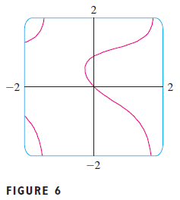
Here is a picture of part of the curve
and if we want to find the slope of the curve at the origin, we just plug in (0, 0) to the derivative
$\sin\left(x+y\right)= y^{2}\cos{x}$
$$\frac{dy}{dx}=\frac{y^{2}\sin{x}+cos (x+y) }{2y\cos{x}−\cos\left(x+y\right)}$$
$$\frac{dy}{dx}|_{at (0, 0)}=\frac{0^{2}\sin{0}+cos (0+0) }{2(0)\cos{0}−\cos\left(0+0\right)}=\frac{1}{−1}=−1$$
because cos(0) = 1

Slide 12
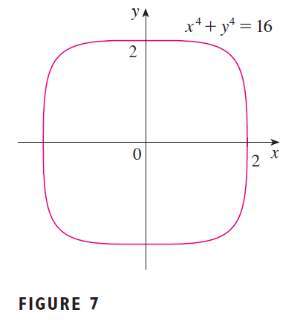
The next example shows that we can use Implicit Differentiation to find the second derivatives as well. And the second derivative tells us the curvature of the curve.
In this diagram, you can see that the curvature is very small or even equal to 0 near the y-axis. At the corners, the curvature will be the greatest.
(when the curve crosses the x-axis, the slope is undefined, so is the curvature.)
However, the calculations involved in the 2nd derivative is too complicated, so we
will skip it in this course. But you are encouraged to skim through the next slide and just get an idea what can be done, and how complicated the 2nd derivative can be.

Slide 13
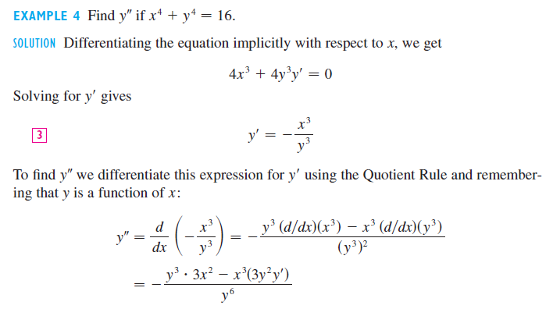
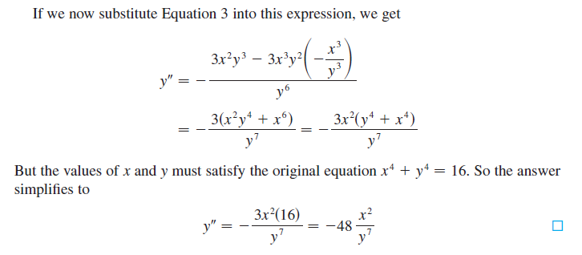
(click to scroll up)

Slide 14
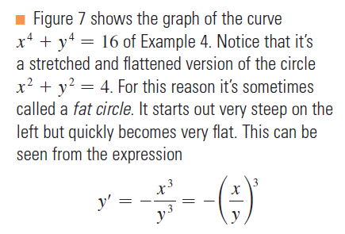

Slide 15
Intermission
(Let’s take a 10 min break)

Slide 16
There is another useful application of implicit differentiation –
to differentiate inverse trigonometric functions!
For example, how do we calculate $\frac{d}{dx}\sin^{−1}x ?$
Clever Solution:
If $y= \sin^{−1}x$ then $\sin{y=x}$
and we can differentiate both sides of the equation using the implicit differentiation technique,
$\frac{d}{dx}(\sin{y)=\frac{d}{dx}\left(x\right)}$
$⇒ \cos{y \frac{dy}{dx}=1}$
$⇒ \frac{dy}{dx}=\frac{1}{\cos{y}}=\frac{1}{\sqrt{1−{\text{sin}}^{2}y}}$ (using the fact that $\sin^{2}y+\cos^{2}y=1)$
$⇒ \frac{ dy}{dx}=\frac{1}{\sqrt{1−x^{2}}}$ Conclusion: $\frac{d}{dx}\sin^{−1}x=\frac{1}{\sqrt{1−x^{2}}}$
You may have a question here, see next slide

Slide 17
In the previous slide, you see that
$⇒ \frac{dy}{dx}=\frac{1}{\cos{y}}=\frac{1}{\sqrt{1−{\text{sin}}^{2}y}}$ (using the fact that $\sin^{2}y+\cos^{2}y=1)$
and you may wonder why we just take the + but not $±\sqrt{}$.
It is because that when we define $y=\sin^{−1}x$, the range of this function is $\left(−\frac{π}{2}, \frac{π}{2}\right)$, and in this range, the cosine function is positive, hence we only take the positive square root.

Slide 18
One more example, how do we calculate $\frac{d}{dx}\tan^{−1}x ?$
Solution:
If $y= \tan^{−1}x$ then $\tan{y=x}$
and we can differentiate both sides of the equation using the implicit differentiation technique,
$\frac{d}{dx}(\tan{y)=\frac{d}{dx}\left(x\right)}$
$⇒ \sec^{2}{y \frac{dy}{dx}=1}$
$⇒ \frac{dy}{dx}=\frac{1}{\sec^{2}{y}}=\frac{1}{1 +\tan^{2}y}$ (using the fact that $1+\tan^{2}y=\sec^{2}y)$
$⇒ \frac{ dy}{dx}=\frac{1}{1+ x^{2}}$ Conclusion: $\frac{d}{dx}\tan^{−1}x=\frac{1}{1+ x^{2}}$

Slide 19
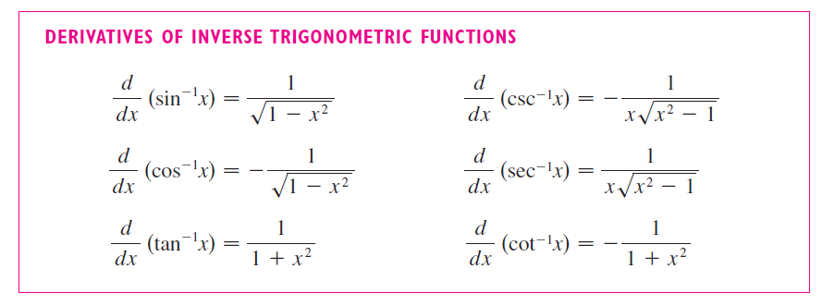
Here is the list of all such derivatives, but you only need to remember the inverse sine and inverse tangent, they are the most commonly used.
The End

